Slide 1
If you can’t find it, what will you use on stage???
Learn how an inventory system can help you get the show on stage.
Presentation by Margaret Messick Costume Inventory Resources www.costumeinventory.com

Slide 2
Only you can turn the stage from a dark, silent floor to a dazzling scene.
But if you can’t find the right costume, prop, furniture, microphone or lights - how will you do it? You don’t want to make or buy everything again.

Slide 3
An Inventory System can help :
Create Records for each item
Do Searches on a variety of criteria to see what you have in stock and find what you need
Print reports (paper or PDF) to share information with others
Rent/Loan/Checkout items to other organizations and keep track of where everything is
Assign items to Productions to create a Production Catalog

Slide 4
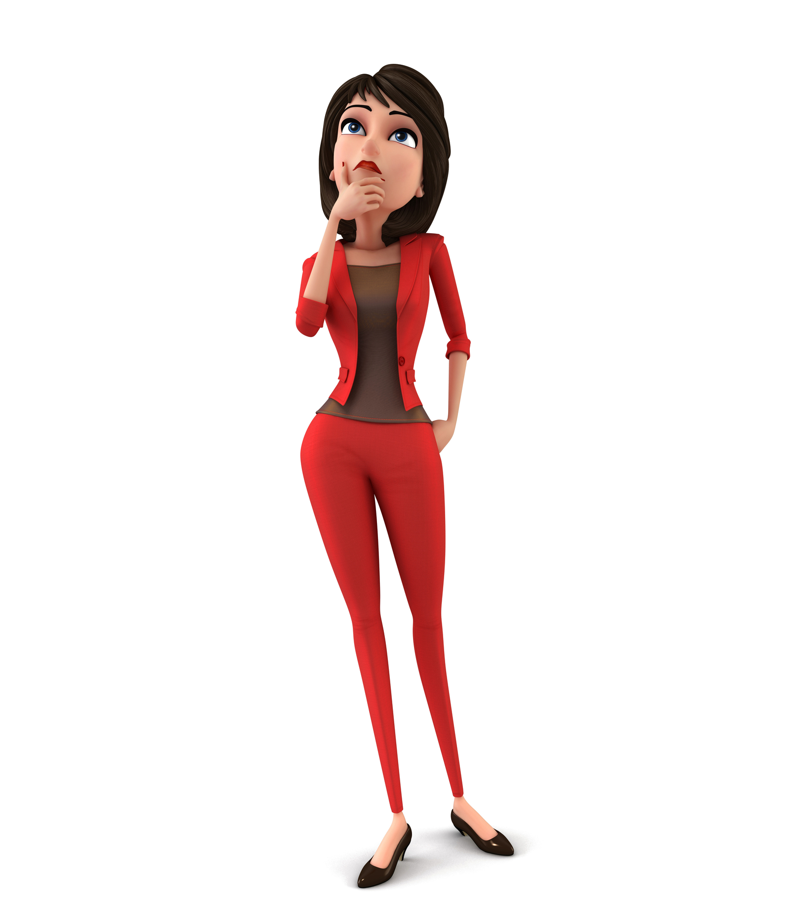
Where Do I Start?
What is your goal for inventorying your collection?
Start Planning
Make preliminary decisions and stick to them
Become the Expert
Train your staff, students and volunteers
Look critically at your storage area
Set your schedule and get started !

Slide 5
1. What is your goal or motivation for inventorying your collection?
Get organized to make better use of your costumes and props/sets?
Generate revenue from rentals?
Your theatre director, department chair, or principal is requiring you to do it?
Teach your students a new skills?
Recognize your goals – make your goals known so it is easier to get the funding, equipment and the support you need.

Slide 6
2. Start planning your project
Recognize that this is a “PROJECT”. Like any project it should have:
A Planning Phase
A Budget
A Source for software, hardware, inventory tags/labels, etc
Many people to help – you can’t do this all by yourself

Slide 7
As part of the planning phase, you will want to Gather data about your theatre:
How many productions do you do each year?
How many students are involved in all aspects of the productions?
How much revenue do you bring in from ticket sales or donations?
How are community members involved? Do you do shows for other schools or organizations?
You want to show that your theatre is very active and productive and that many students and community members benefit from the theatre.

Slide 8
Make Estimates
How many of each group do you have ? What do you think the value is?
Costumes
Props/Sets
Wigs
Jewelry
Lighting Equipment
Sound Equipment
Tools

Slide 9
List the Benefits of having an inventory
An inventory will provide:
An accurate count of your costumes, props etc. plus an accurate value of the collection
The ability to search for costumes / props
The ability to plan and prepare for productions knowing what you have
A way to set up a rental program – to generate revenue and track where everything is
The opportunity to teach students new skills

Slide 10
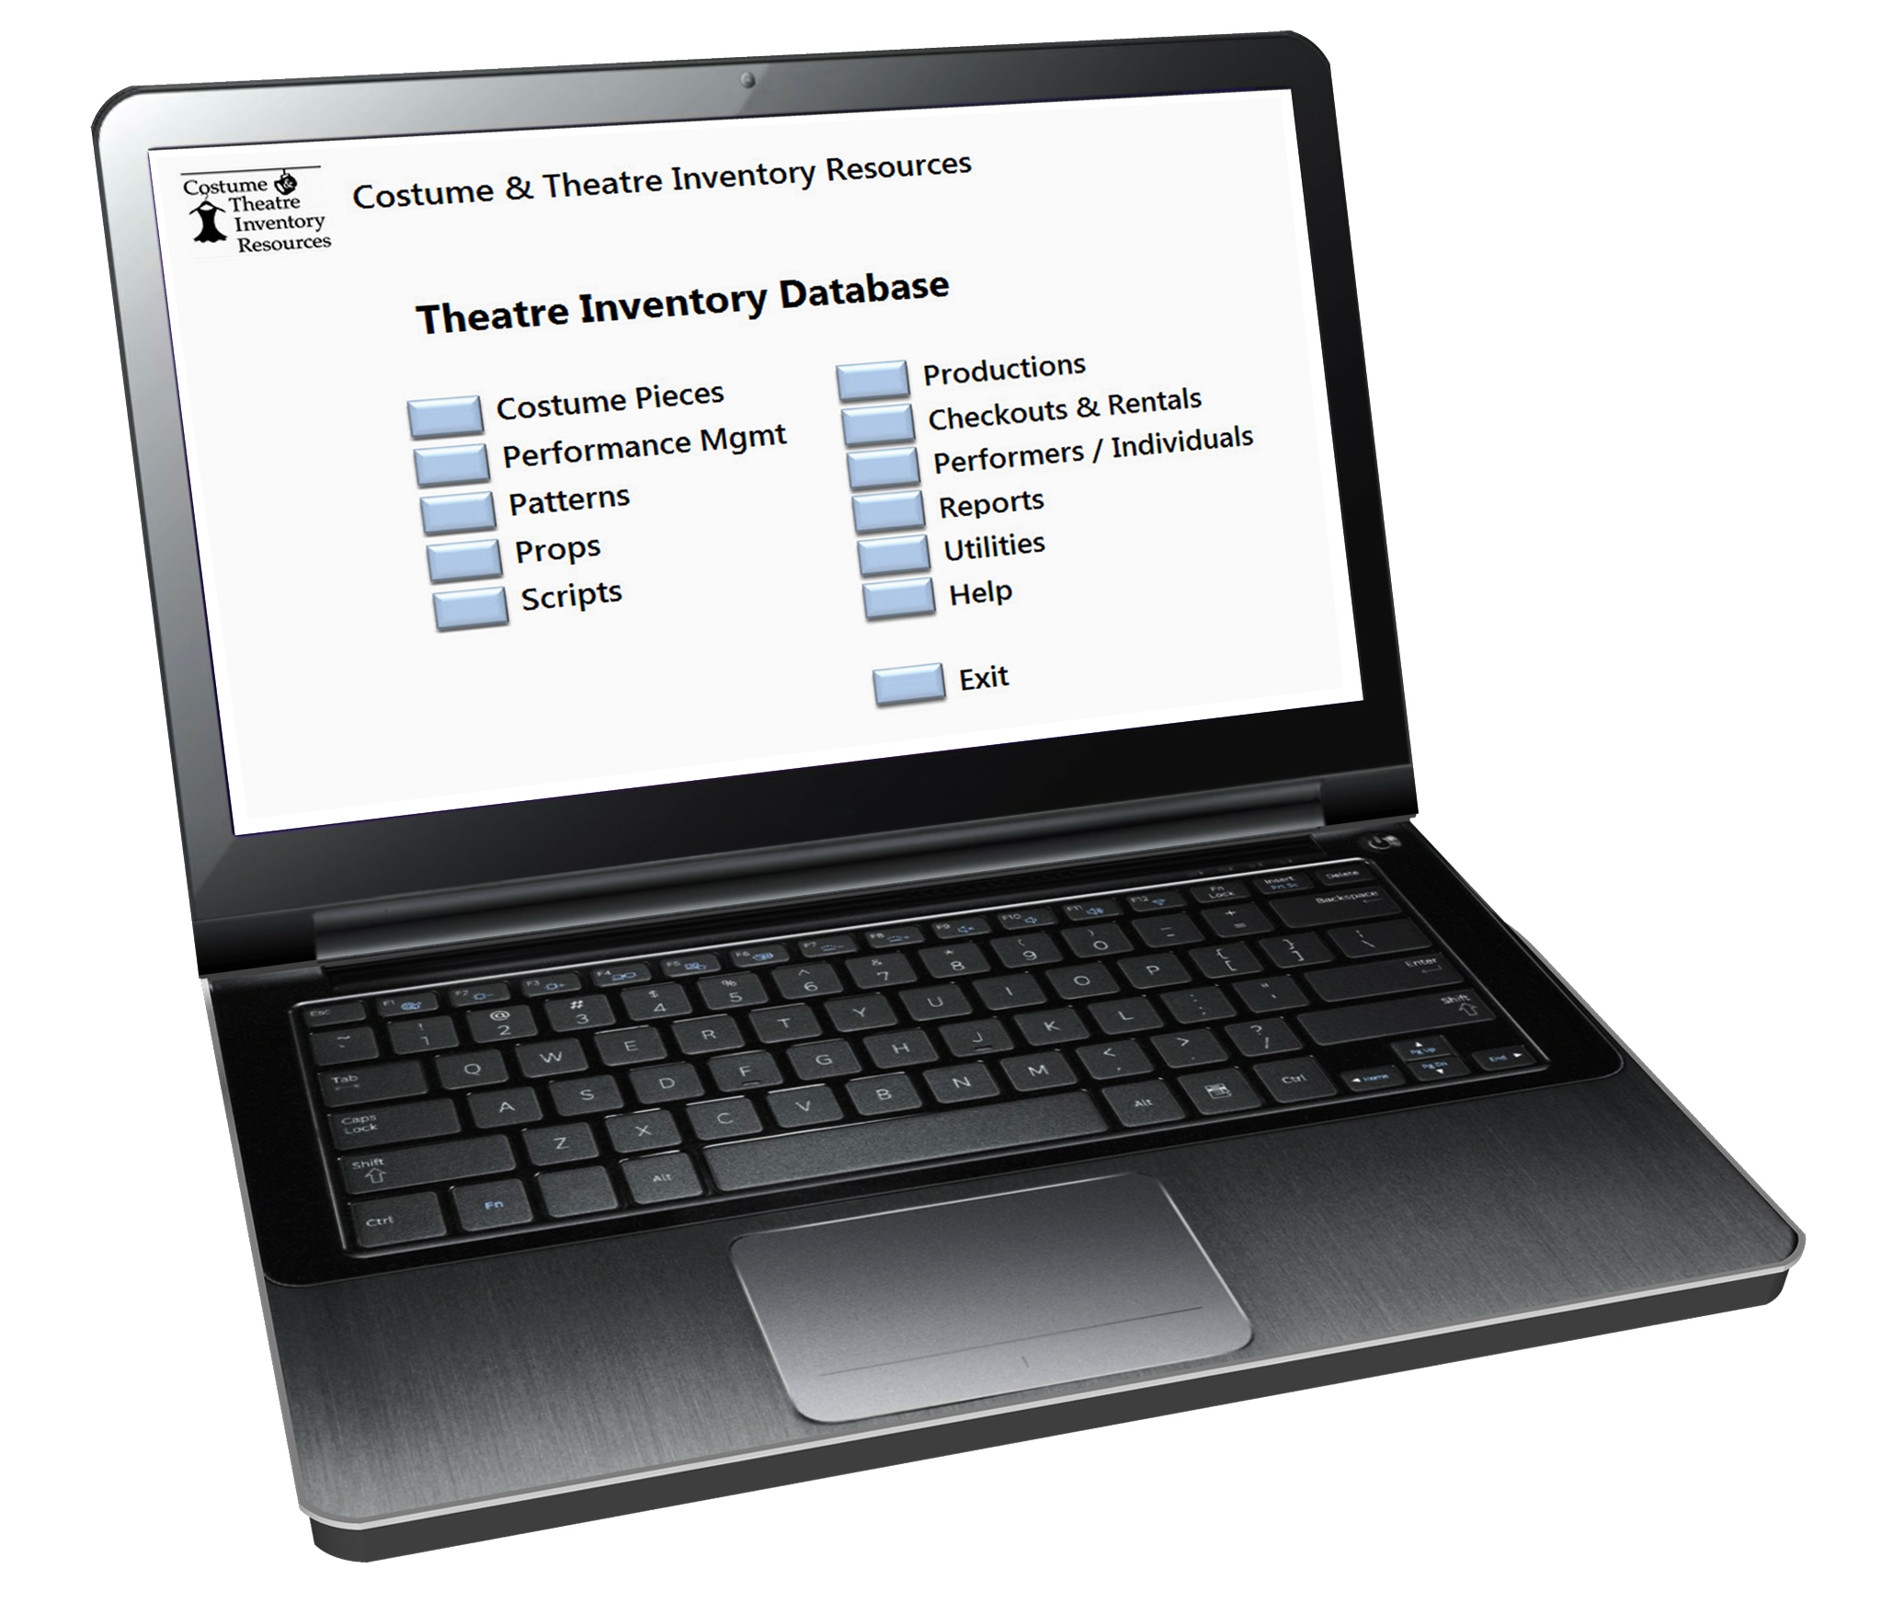
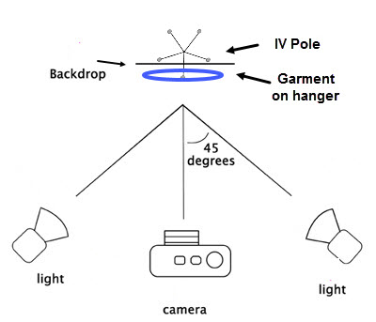
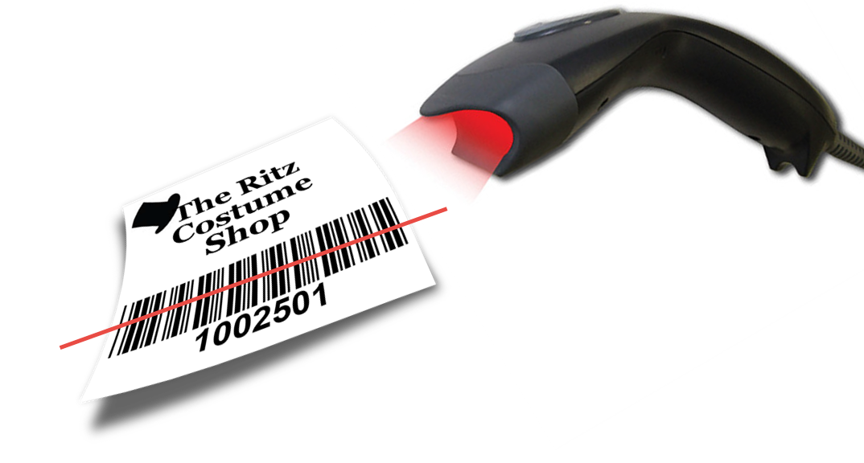
Skills for students to learn
Computer Skills
Costume and Props/Sets knowledge
Inventory management
Customer relations
Photography
Set up a Photo Station

Slide 11
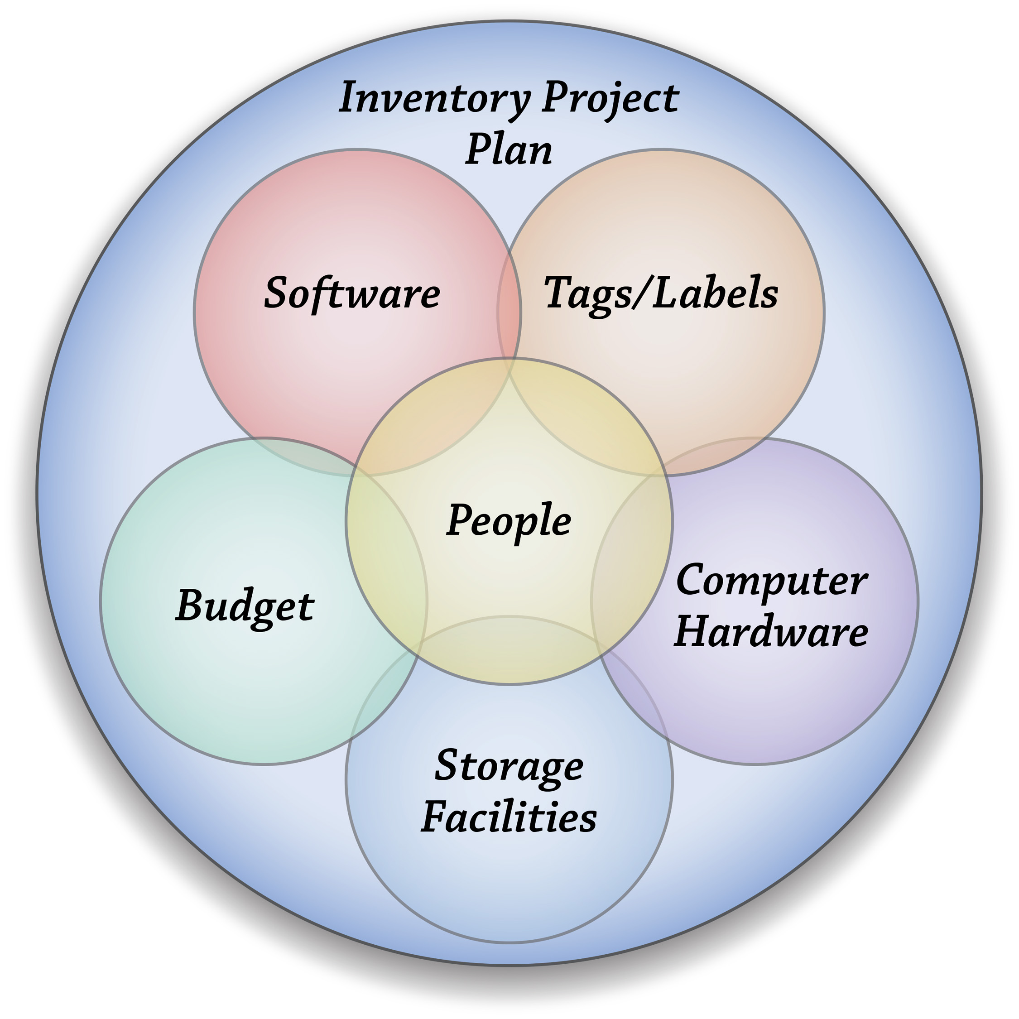
The Inventory Database Project Plan
People
Software
Inventory Tags & Labels
Hardware
Storage Facilities
Budget

Slide 12
As you create your plan and proposal - think of each of these areas:
❖ People
People are the most important part of the plan. Who is in charge? What staff, volunteers, or students are available? How much time can they commit to the project? When are they available? How much training will they need? Who in the organization has to approve the project? What do you need to convince them to allocate the funds and resources?
❖ Software
How will you store your records? In a Database or Spreadsheet? What functions do you want in the software? Do you want to include photos? Who do you want to have access to the data? How much control do you want to have?

Slide 13
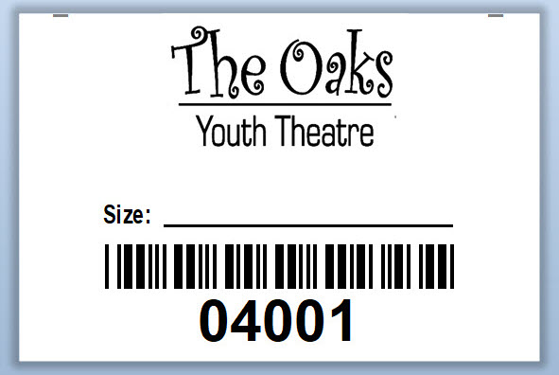
Your plan, continued…
❖ Identifying Tags / Labels
Identifying tags for costumes and labels for props, accessories, shoes, and equipment are needed to track each item. What kind and how many of each kind do you need? What numbering system do you want to use - sequential numbers or letter and numbers combined? Do you want barcodes? Do you have the tools to apply tags to garments (small iron, sewing machine) ?
❖ Computer Equipment
PC or Mac or In-the-Cloud?? Do you want to share it on a network? Do you need access from multiple devices and locations? How much IT support do you have (try to be realistic) ? Can you get more IT support if you need it? If your tags have barcodes you will need a scanner for each computer. What kind of barcode scanner do you want?

Slide 14
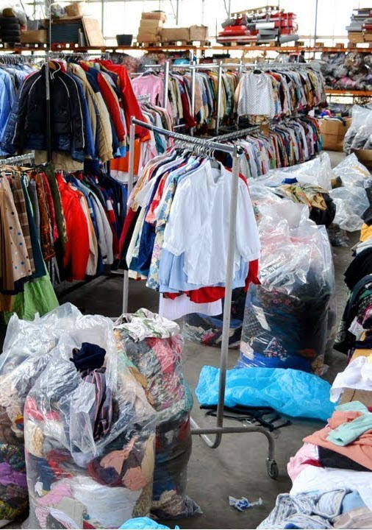
Your plan, continued…
❖ Storage
How are things organized now? How would you like to change it? Do you need more racks, shelves, bins, ladders ?? Are you planning a move soon? Does your storage area meet fire codes?
❖ Budget
All parts of the plan require money. Where can you get the money - existing budget, grant, donations, rental payments ?? How much do you need? When will the funds be available? How can you bring in more income to support the inventory system? Look at the Resource Guides at www.costumeinventory.com for a sample budget.

Slide 15
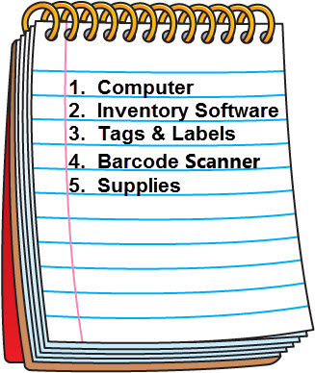
3. Make decisions and stick to them !
Investigate which software / database to use
Test a variety of tags and labels from different manufacturers
Check if your current computers meet your needs – if not find new / donated computers
Buy the software, hardware, tags & labels, barcode scanners, etc

Slide 16
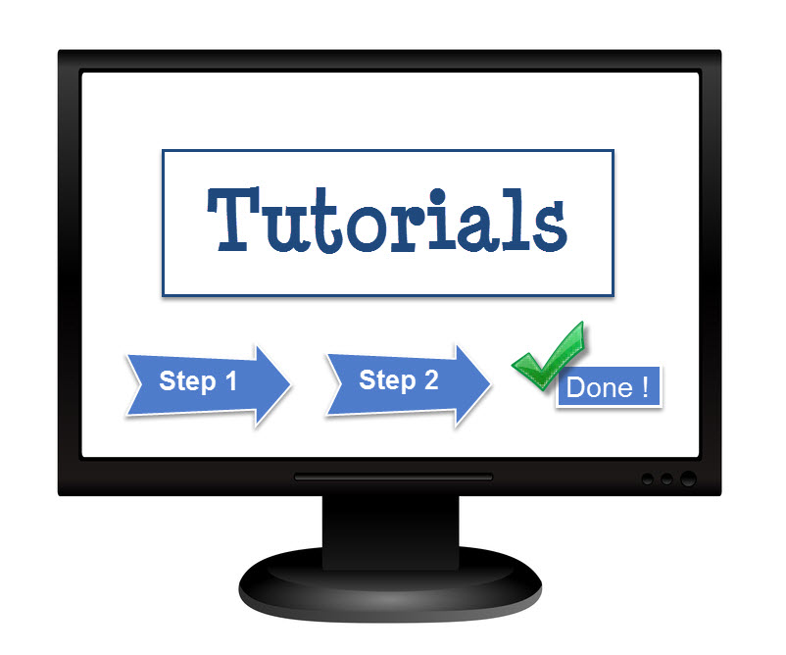
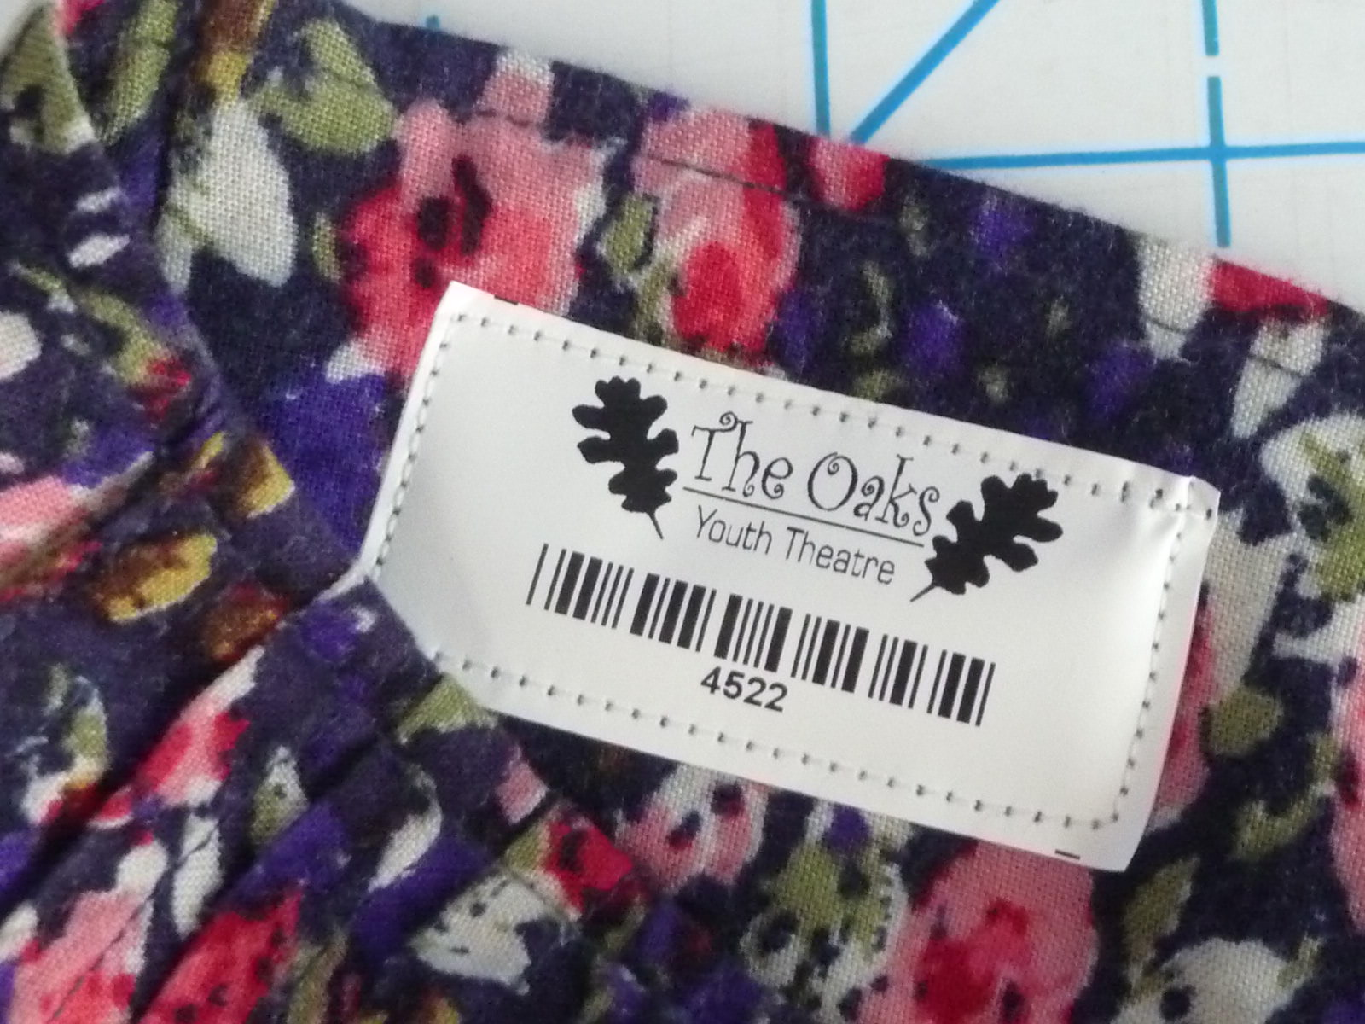
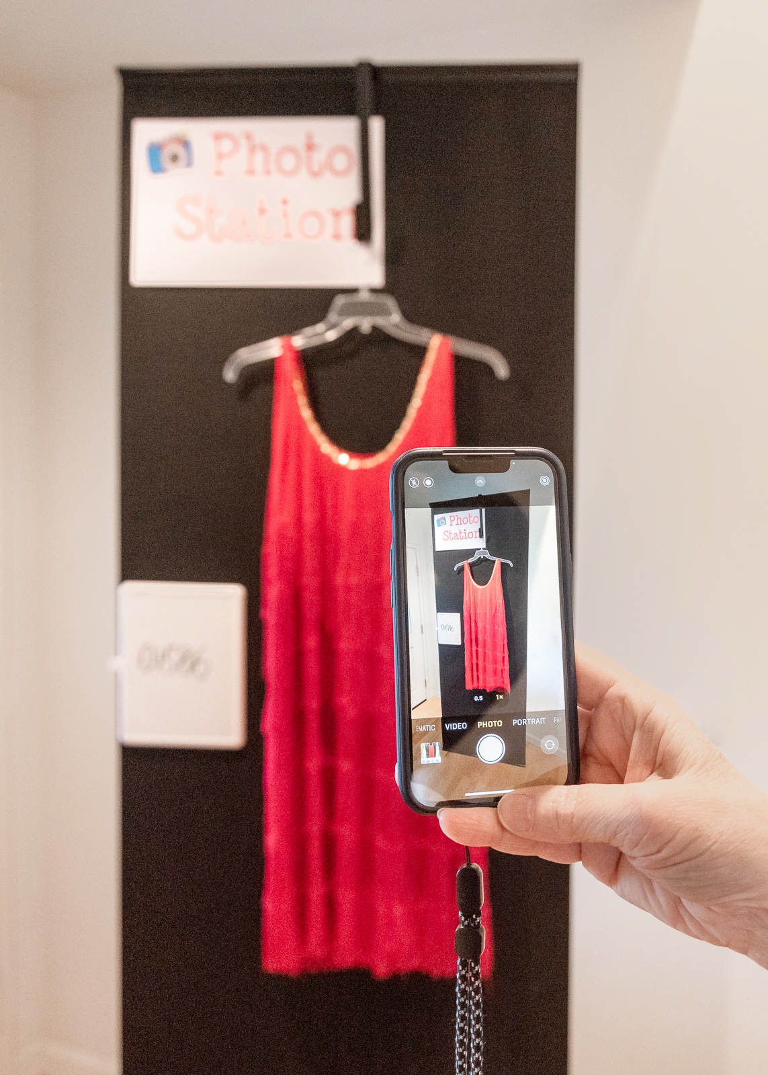
4. Become the Expert !
Take time to learn the software that you purchase (Check out the Tutorials, User Guide and any Resource Guides)
Take 25 or so tags / labels and apply them to your garments / props
Make decisions of where the tags should go on each garment type
Practice taking photos, set up a photo station
Make a floor plan of where the costumes are / will be stored

Slide 17
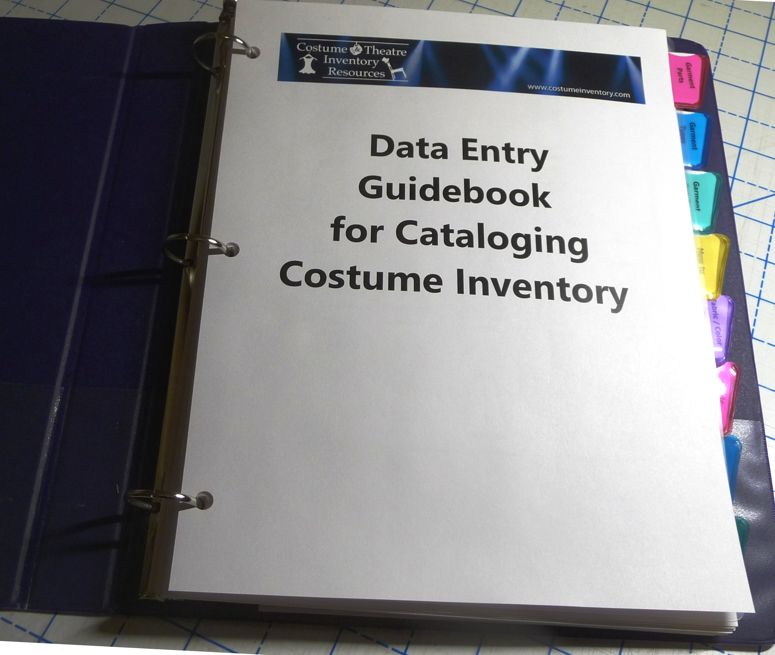
5. Train everyone !
Gather your training materials and have them available
Download the Data Entry Guidebook to help teach students / volunteers about costume style, design features and fabric
Set aside training time for each new student/volunteer
Teach everyone how the tags should be applied and where the tags should go. The goal is consistency !
Reward your staff / volunteers ! Tell them how much you appreciate their hard work.

Slide 18
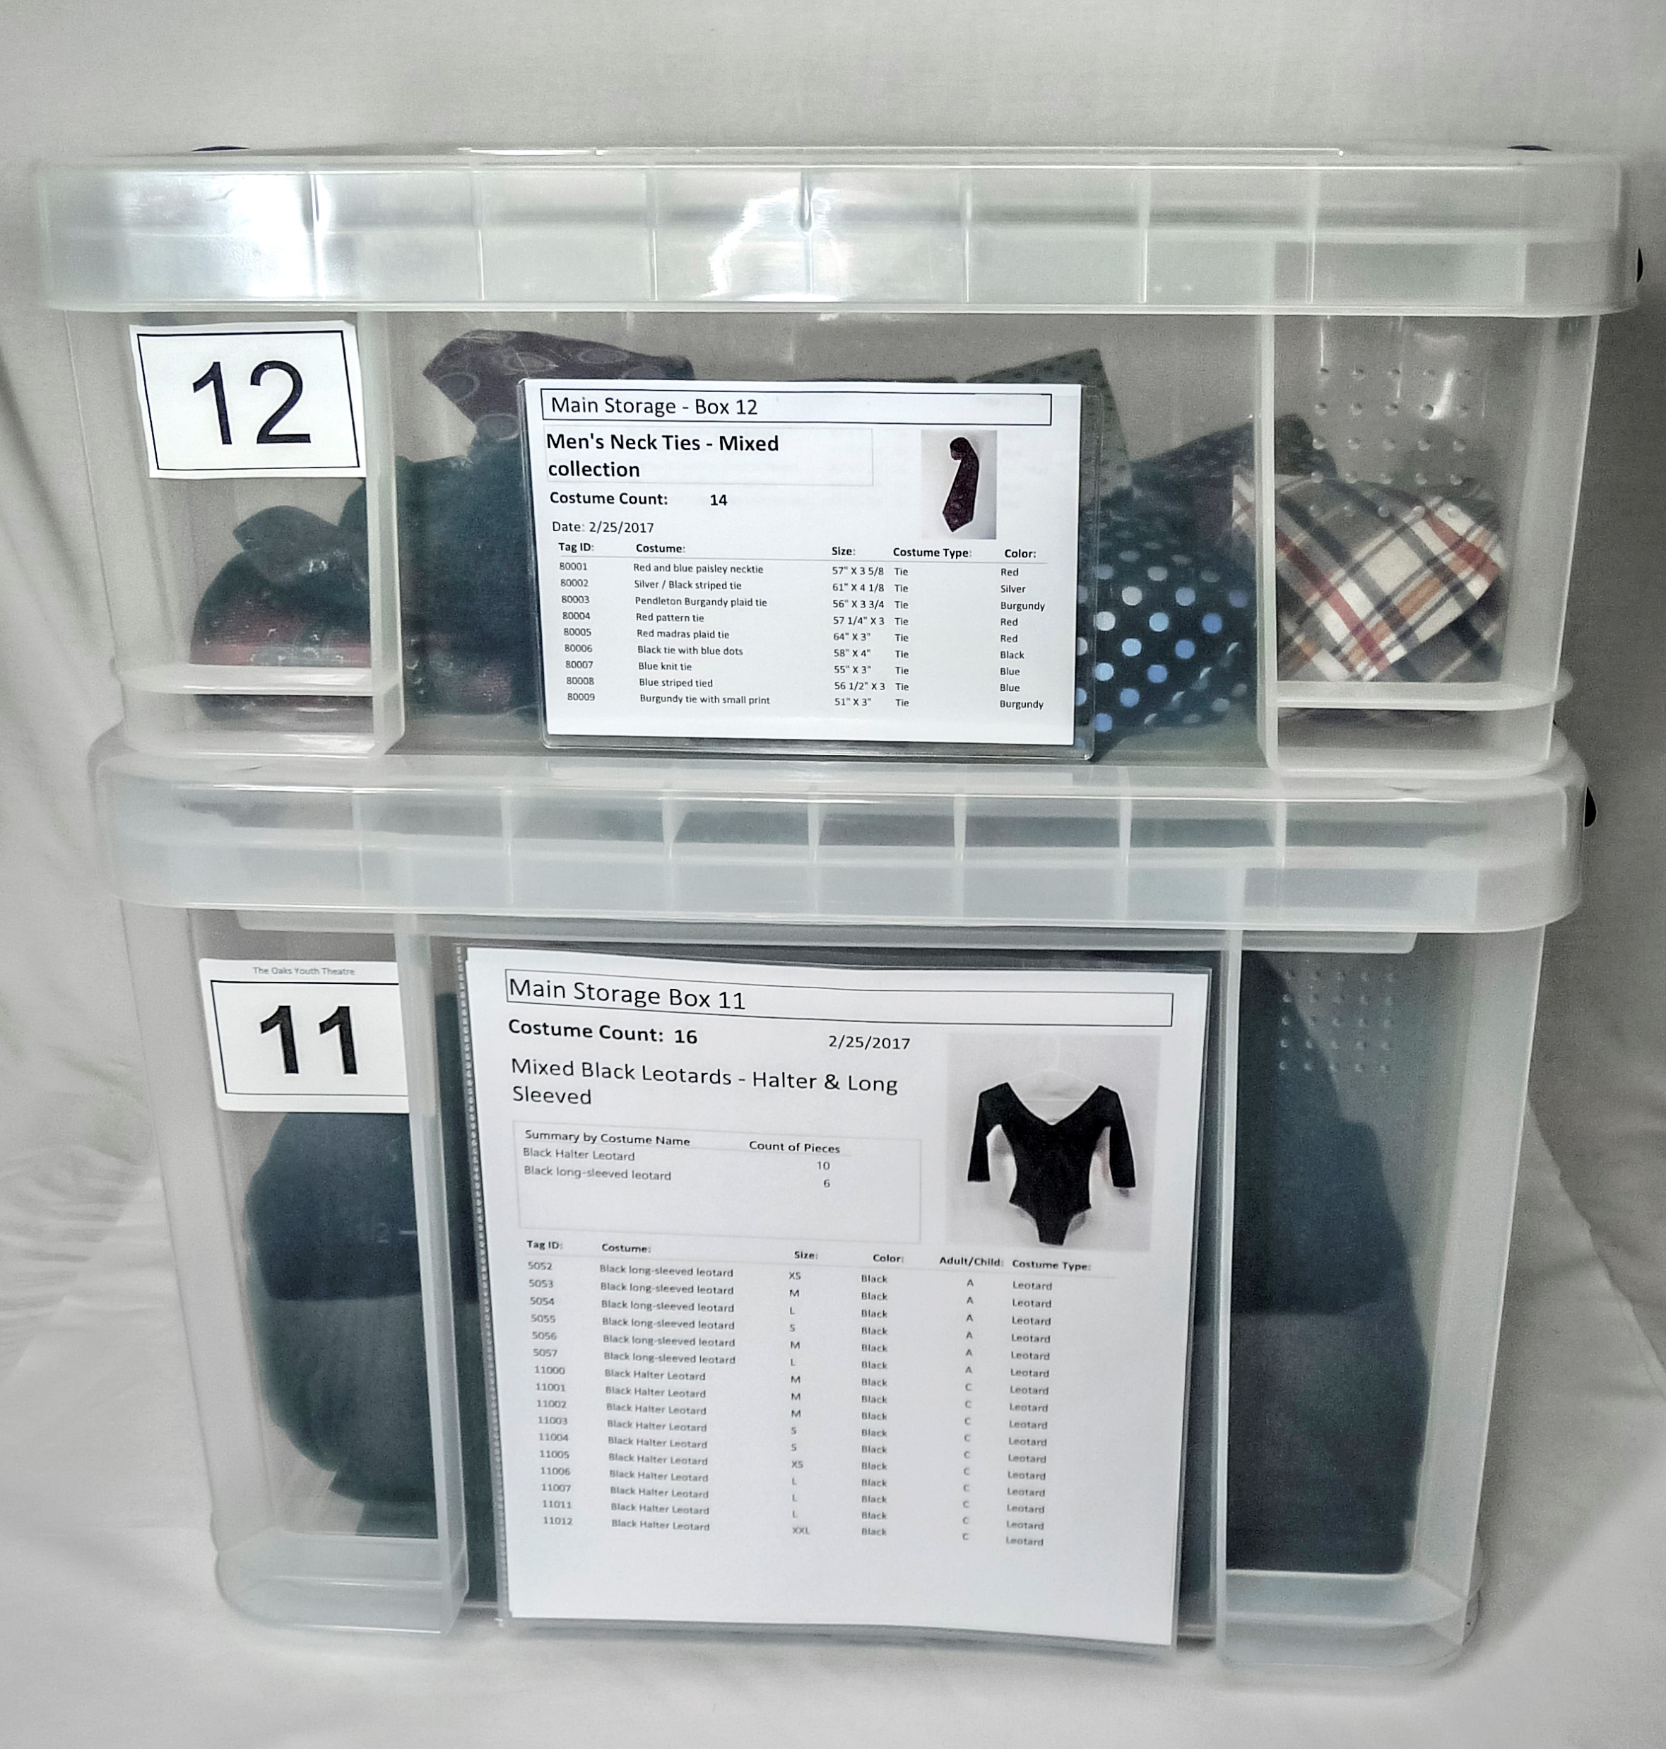
6. Look critically at your storage area
Decide how it is best to store your items – on hangers, plastic bins, hooks on the wall, shelves … The way you have it now may not be how you want it in the future.
Calculate how many racks, bins, shelves you need.
Review the bins. Most costume shops have a variety of shapes and sizes. Consider getting new bins that will stack together.
Know your local fire department regulations. Keep ample space between costumes and the walls and ceilings. Have wide walkways.
Review your stock – are there things to get rid of?

Slide 19
7. Set up a schedule and get started !
Set up a TimeLine with the following dates when:
The money is available to purchase what you need
The hardware and software will be installed
The inventory tags and labels will have arrived
The storage area is cleaned and ready to work in
There are no major productions/builds happening in the costume / props shop

Slide 20
Schedule, continued
Contact your staff, students and volunteers to determine their availability
Make and publish the schedule so everyone (management, principal, staff, volunteers and students) all know what is happening when
Review the Resource Guide (website) on “Suggestions for a Costume / Prop Inventory Day” to help you decide how to prepare for the day you start inventorying everything.

Slide 21
Things to include in your Proposal:
Do the Numbers – how many productions, how many students are served, how many costumes, props you have
Outline the Benefits - to the school/theatre, students, community
Show your plan – what hardware/software you need, what tags to use, a priority list of what costumes/props will be inventoried first, explain what training is available and how everyone will be trained
Show your schedule – list of people committed to help, time line when everything will be ready, a calendar of the work days
Show your budget – prepare a spreadsheet (like example)
Summarize why you need this project now, benefits vs costs, and your willingness and commitment to do the project

Slide 22
Once you have a inventory system set up you will…
Setup the database to have just the data you want – enter the Storage Locations, Lookup Table selections (Costume Type, Cable Connectors, etc)
Create a database record for each item to identify each item – costume piece, prop, set piece, light fixture, cable, gobo, sound equipment, wigs
In the record assign the item an inventory ID number, describe it using the lookup tables and description fields, include a photo, storage location, costs, rental fees
Apply an inventory tag (garments, softgoods) or adhesive label (accessories, props, set pieces, equipment) to each item.
Put the item in its assigned storage location

Slide 23
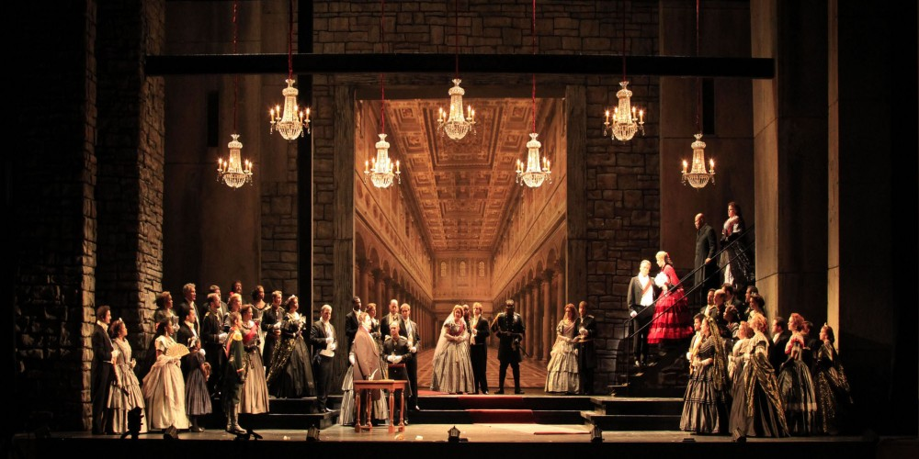
Now that you have everything and know where it is – its time to turn the stage into a production !
Atlanta Opera, 2011

